Slide 1
object-oriented Python stock tracking application CEIS150
May – June 2023
Professor: Dr. Omar Haddad
Student: . B. Lee Ecke
A DeVry University Student Production

Slide 2




Introduction
This Course Project is culmination of Class CEIS150 that I attended at DeVry University in May-June 2023. This presentation will use Python object-oriented techniques to develop a stock tracking application. The application will have both console and GUI (Graphical User Interfaces).
The students were provided software, including Microsoft Office 365, Spyder IDE, version 5.4.3, a powerful scientific IDE for Python and Anaconda, a desktop graphical user interface (GUI) included in the Anaconda® Distribution that allows launching of applications and managing of conda packages, environments, and channels without using command line interface (CLI) commands. All Software was provided free to students by DeVry University for this project.

Slide 3

Mod 1: Software Environment Setup Mod 2: Class Diagrams, Class Coding, Unit Testing Mod 3: Text-Based User Interface, Summary Report Mod 4: Inheritance, Summary Report Mod 5: Creating a Chart Mod 6: Loading Data Mod 7: GUI
Modules 1- 7
Table of Contents:

Slide 4

Objectives
To use Python object-oriented techniques to develop a stock tracking application
Processing the historical stock data produces raw data for generating profit/loss reports
Data storage will allow users to save and retrieve stock data
System uses Python libraries to create charts

Slide 5
Module 1
Software Environment Setup
5

Slide 6
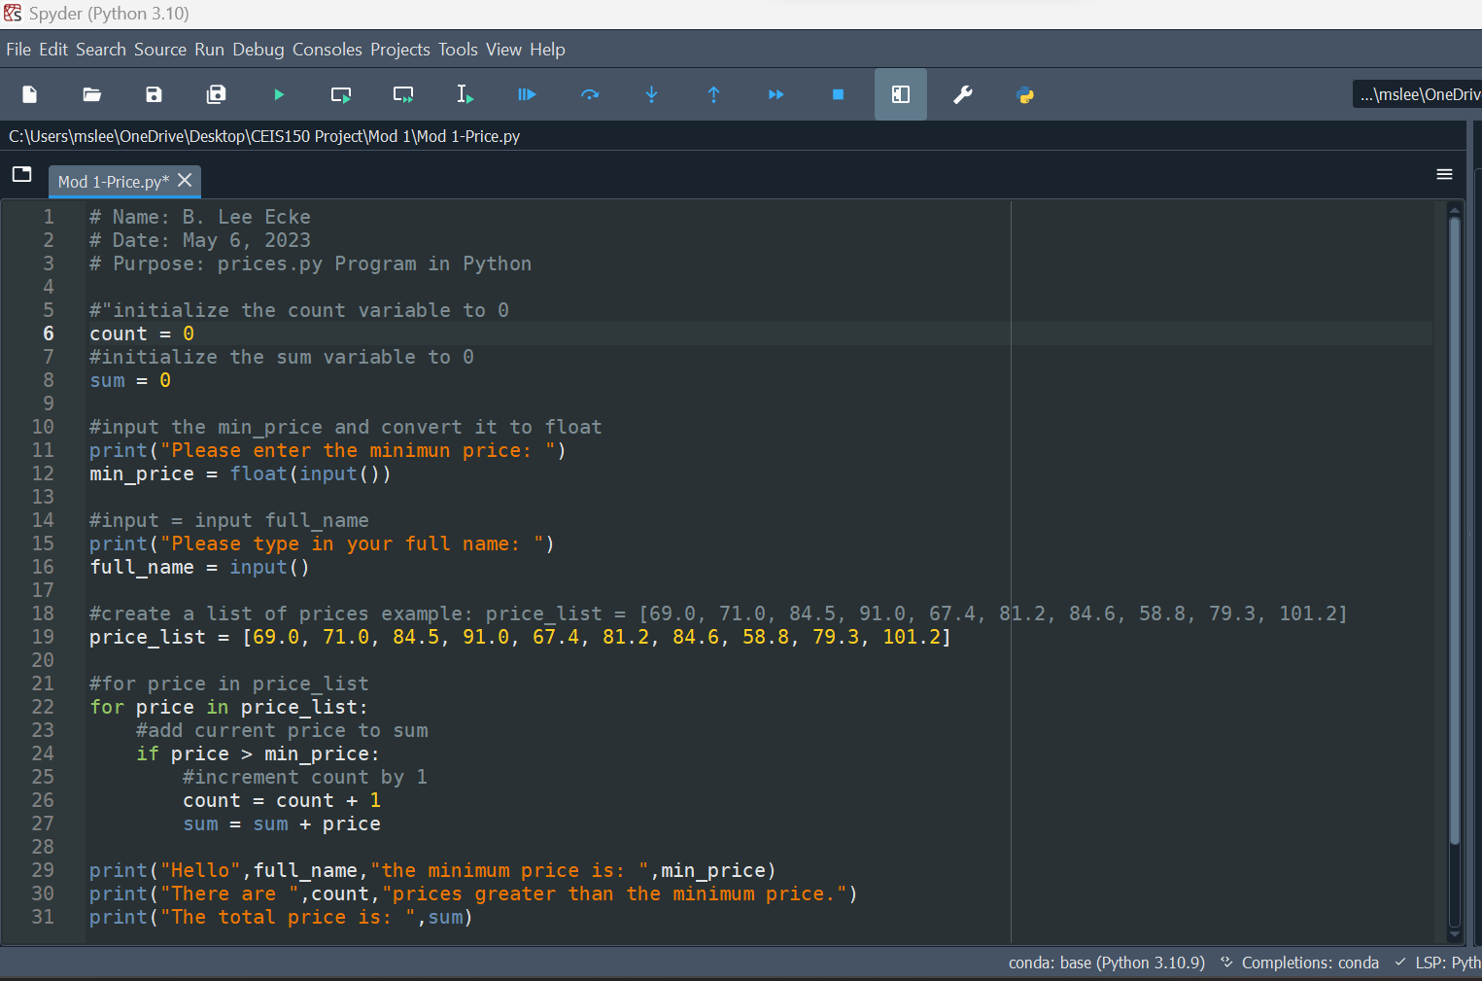
Program Code
6

Slide 7
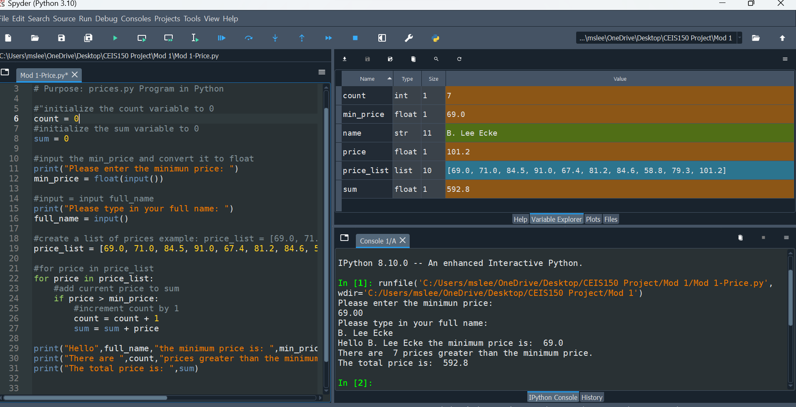
Program Results
7

Slide 8
Module 2
Class Diagrams
Class Coding
Unit Testing

Slide 9
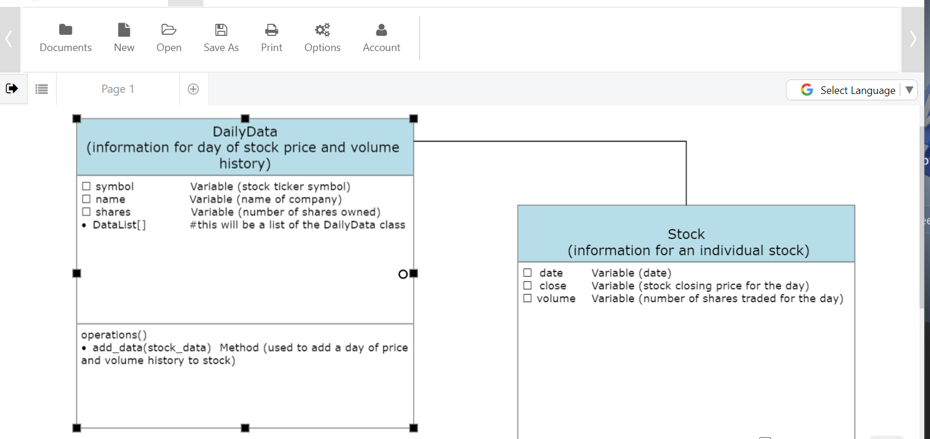
Class Diagram
9

Slide 10
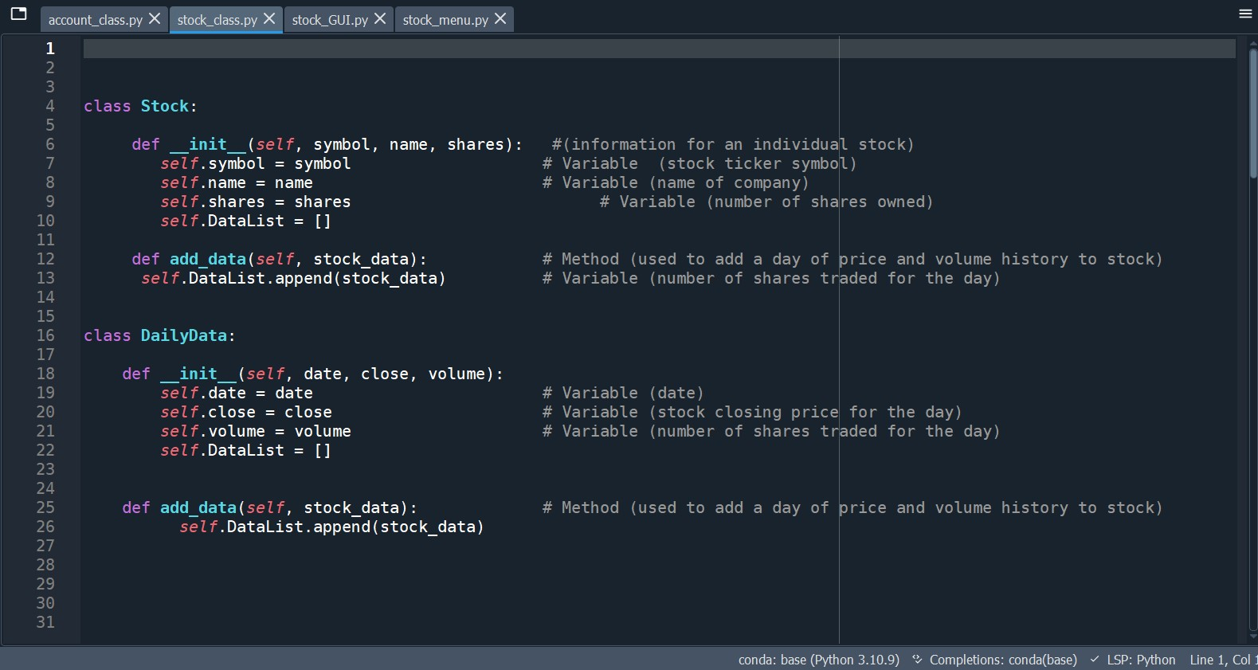
Class Code
10

Slide 11
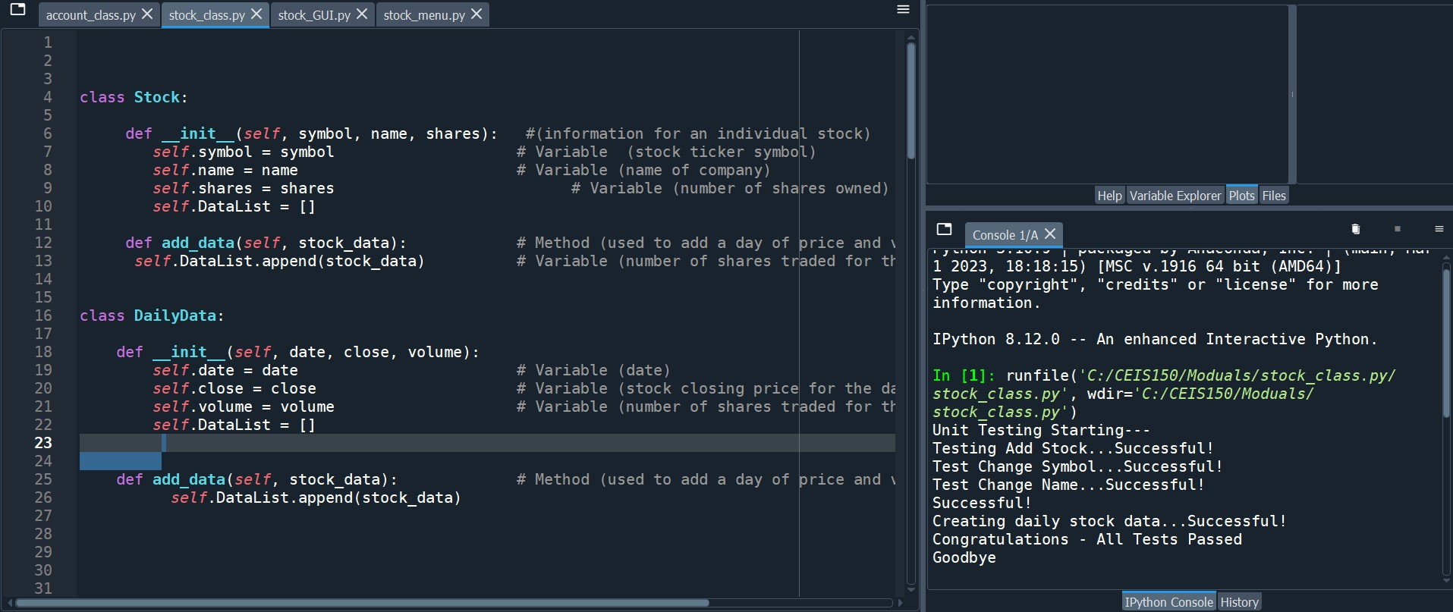
My Unit Test
11

Slide 12
Module 3
Text-Based User Interface
Summary Report

Slide 13
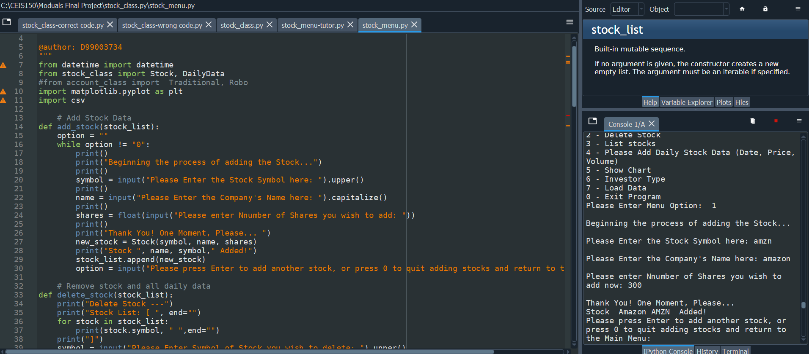
Adding a Stock
13

Slide 14
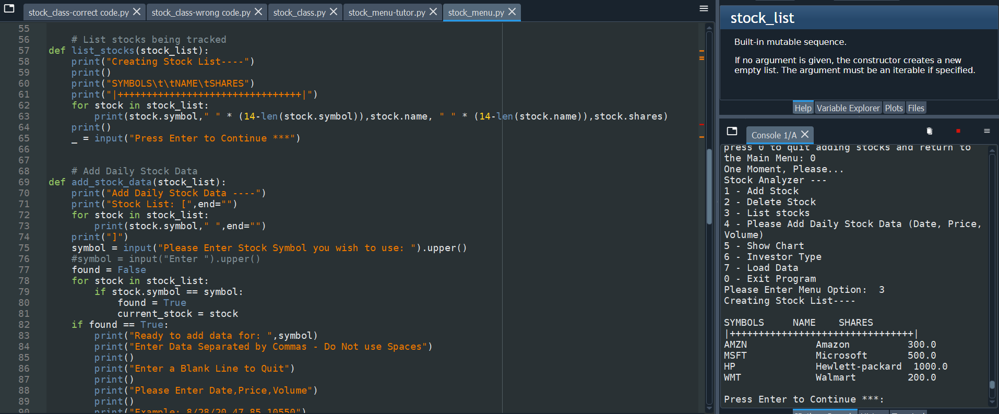
Listing 3 Stocks
14

Slide 15
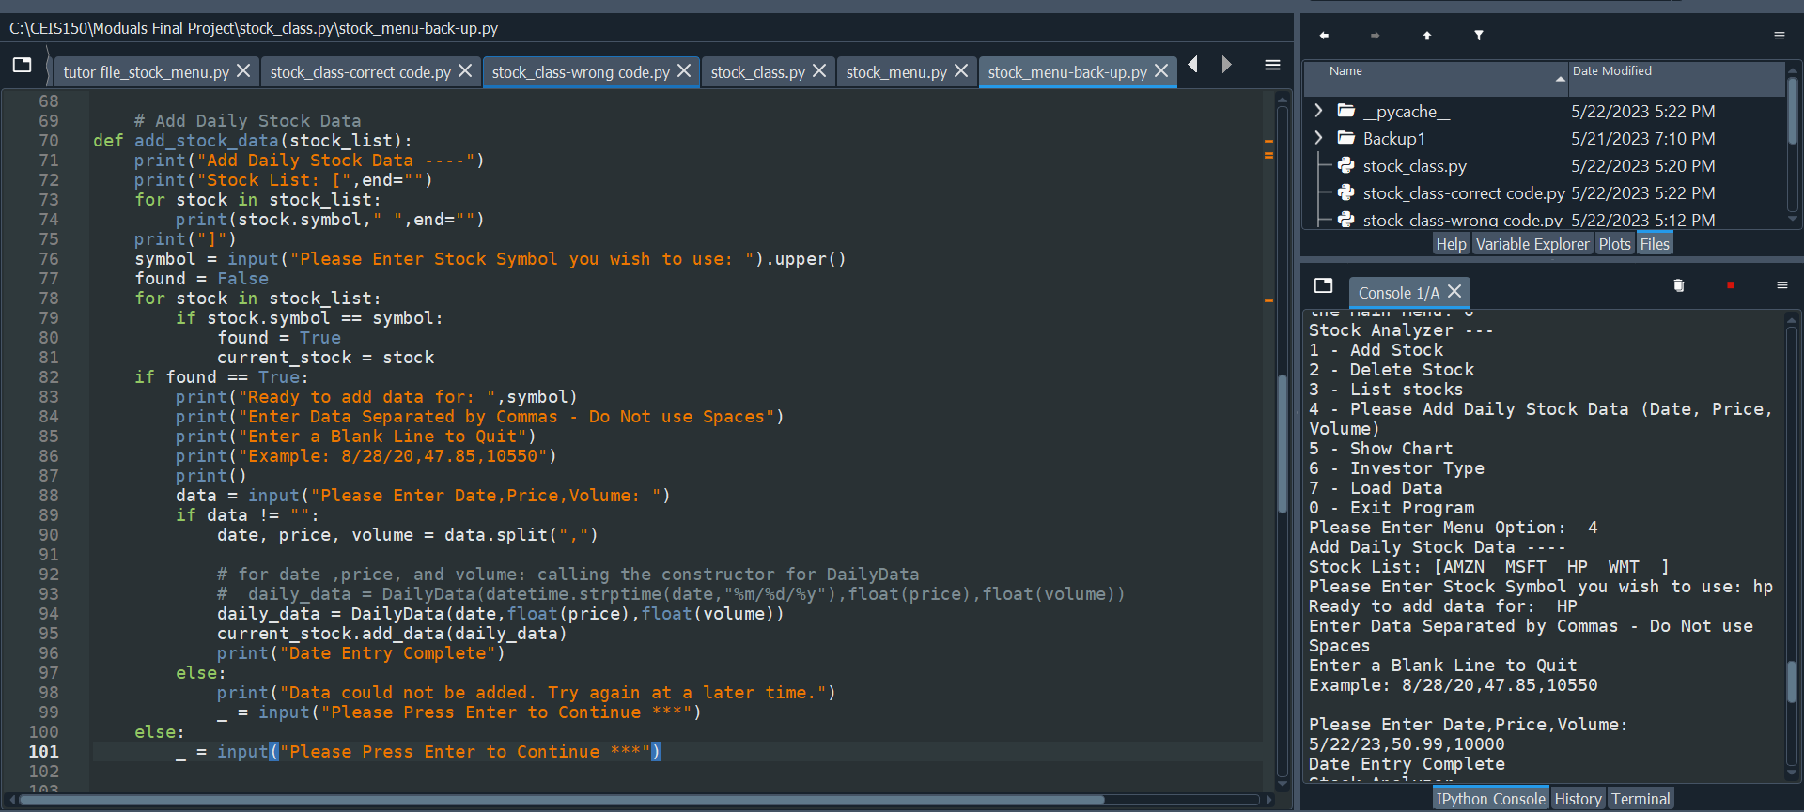
Daily Data
15

Slide 16
Module 4
Inheritance
Summary Report
16

Slide 17
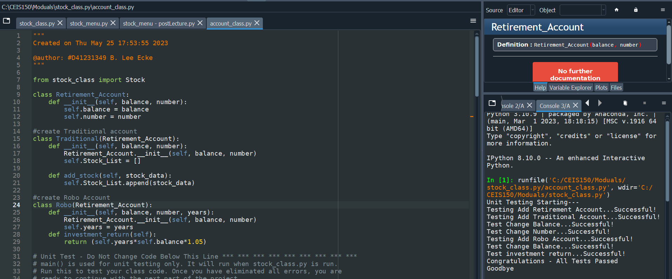
Unit Tests
17

Slide 18
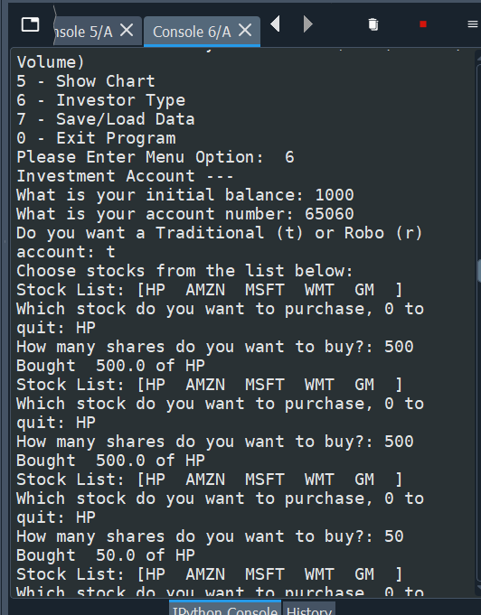
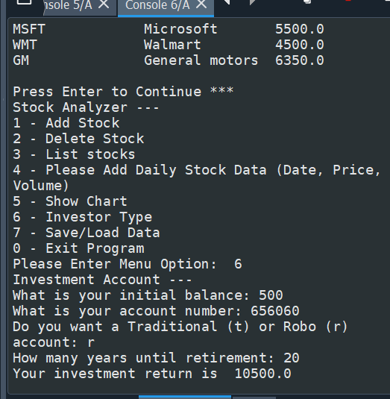
Stock menu program
18

Slide 19
Module 5
Creating a Chart
19

Slide 20
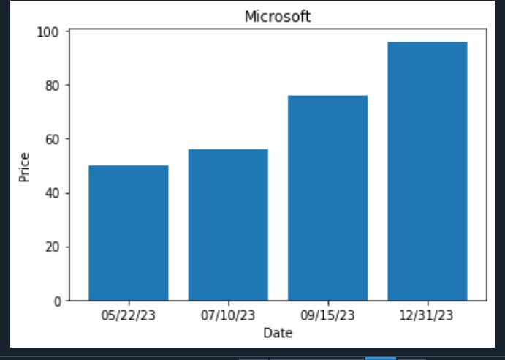
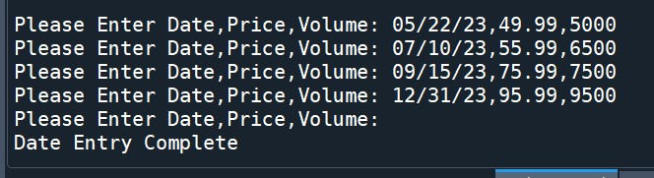
Bar Chart
20

Slide 21
Module 6
Loading Data
21

Slide 22
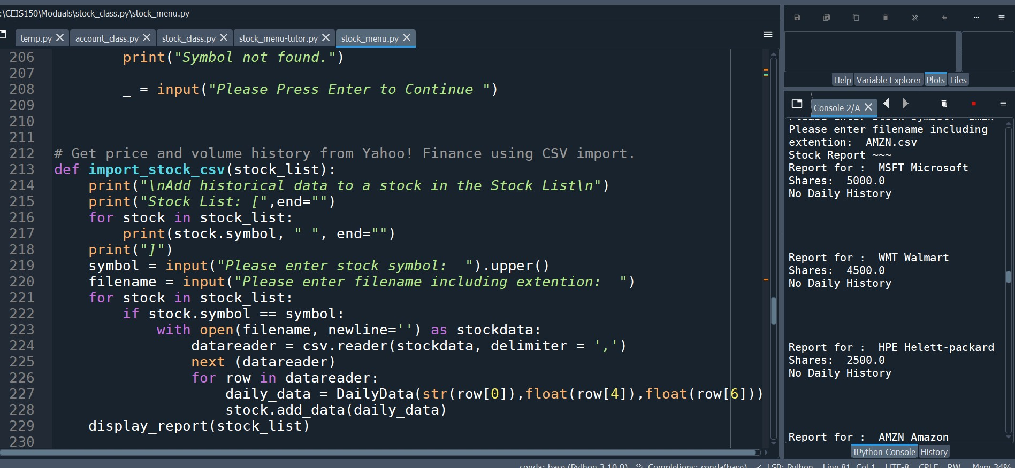
Importing data
22

Slide 23
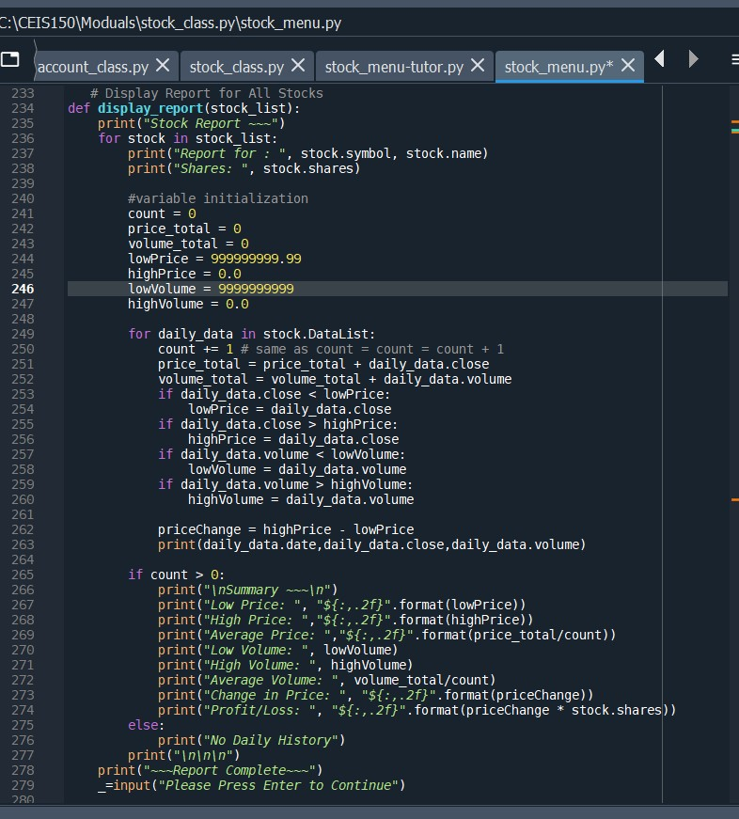
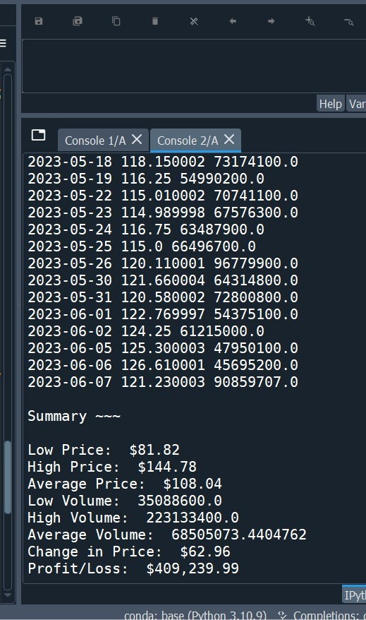
Importing data (cont’D)
23

Slide 24
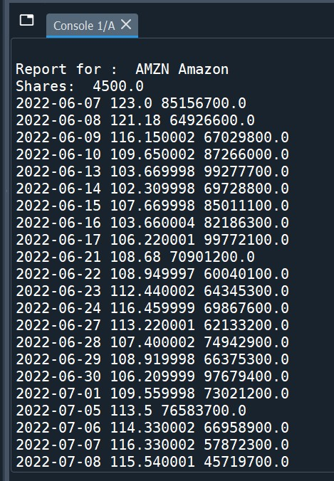
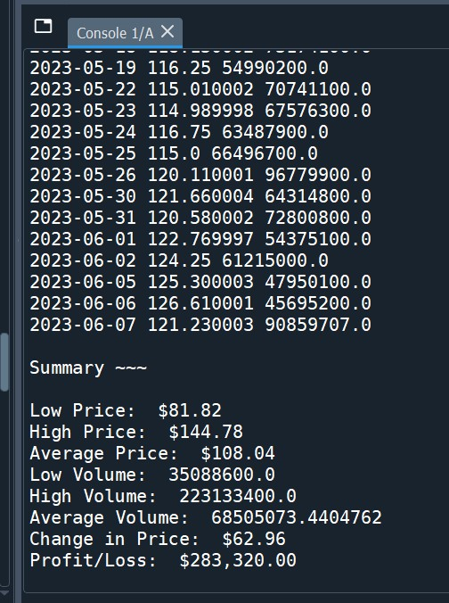
Importing data (cont’D)
24

Slide 25
Module 7
GUI
25

Slide 26
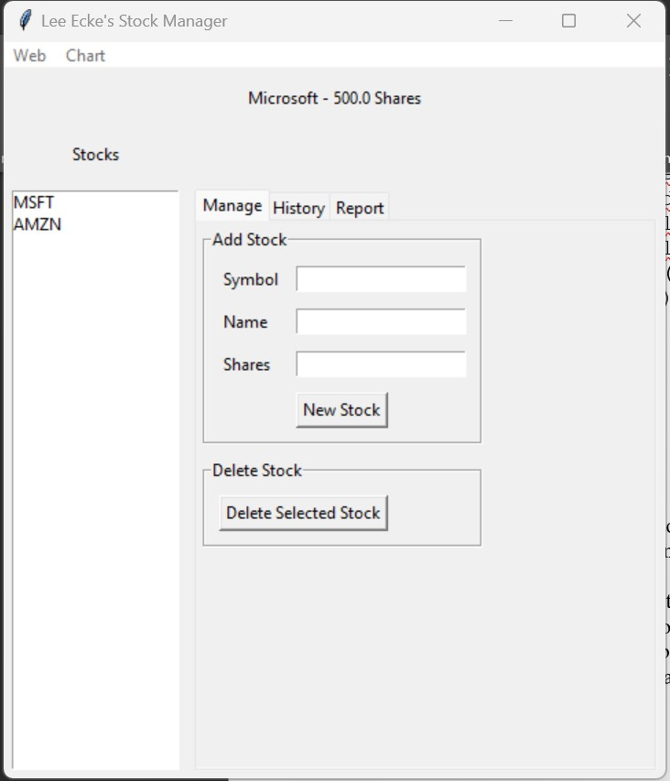
Stocks in GUI
26

Slide 27
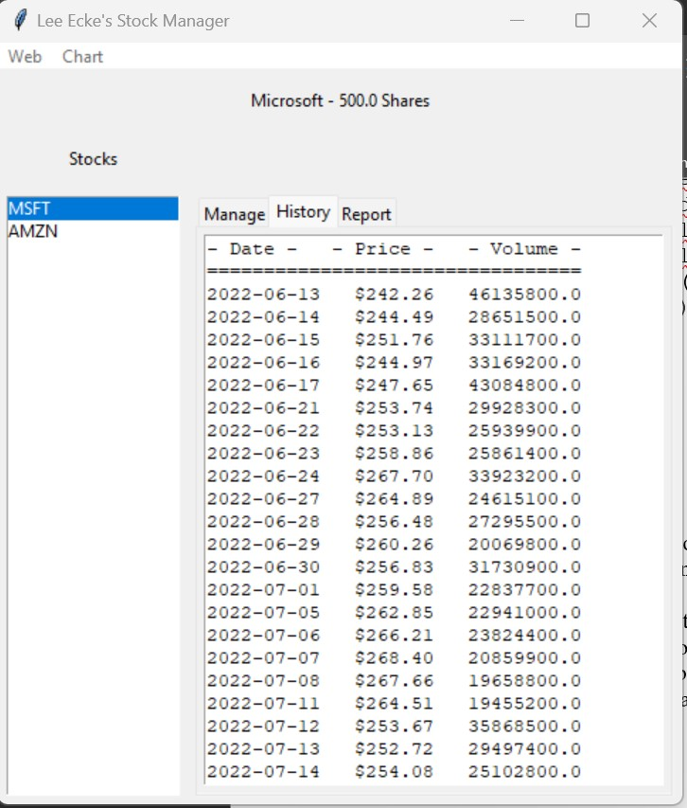
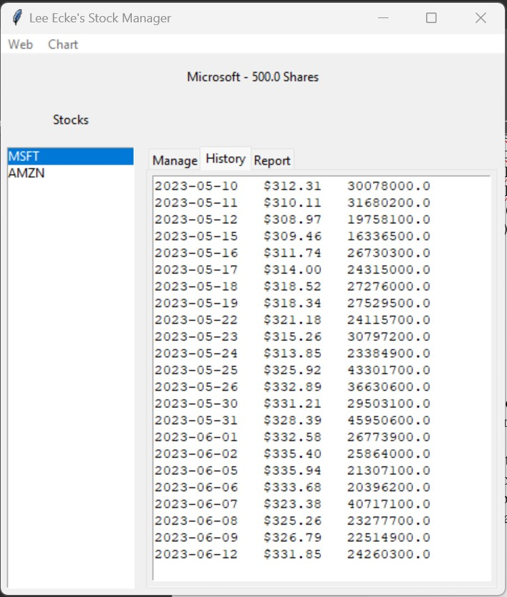
History Tab
27

Slide 28
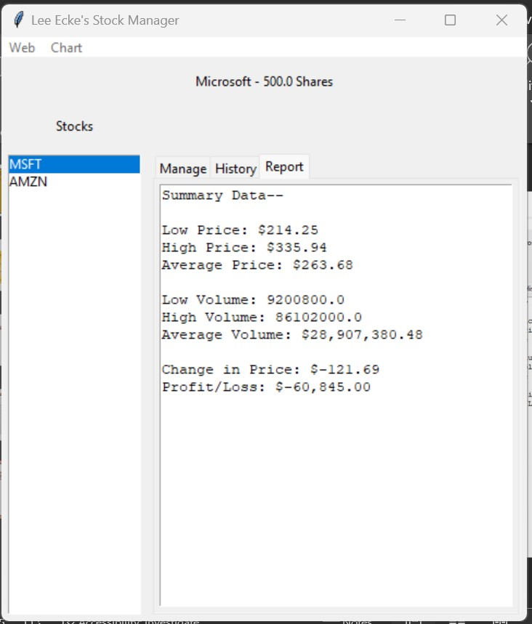
Report Complete
28

Slide 29
What I Learned from this Project, page 1
Mod 1: Python has three types of control structures: conditional statements, loops, and function calls, also known as Sequence control structures , Selection control structures, and Repetition control structures:
Sequential – [is the] default mode.
Selection - used for decisions and branching.
Repetition - used for looping, i.e., repeating a piece of code multiple times ¹
Mod 2: Class is a Composite Data type in Python. It contains data members and functions. Constructor-when we create an object of a Class it’s called a constructor. In Abstraction, the state of a particular object. is made up by Values.
Mod 3: In object-oriented programming a class is a template definition of the methods and variables in a particular kind of object. An object is a specific instance of a class; it contains real values instead of variables. Classes containerize data and behavior that should be grouped together, leading to better organized and easier to read code.
Mod 4: In OOP, is-a and has-a have reusable advantage either by implementing inheritance (is-a relationship) or object composition (has-a relationship). The is-a inheritance relationship are qualities that are part of the object, whereas a has-a composition relationship possessive of things attributed to the object.²
29
1. https://www.educative.io/answers/what-are-control-flow-statements-in-python
2. https://www.w3resource.com/java-tutorial/inheritance-composition-relationship.php

Slide 30
What I Learned from this Project, page 2
Mod 5: The Library files have an DDL extension, (Dynamic Load Libraries) that allow an automatic linkage with our program when it is run. It searches for that library and extracts the functionalities of that library and interprets the program accordingly.¹ The entire Library or just a module can be imported. Then In the code below, the library is referenced accordingly.
Mod 6:
Web Scrapping (or data scraping) is a method used by businesses and others to collect content and data from the internet. This data is usually saved in a local file so that it can be manipulated and analyzed as needed.
Iterators are equal to objects with a collection of items. In other words, it refers to a sequence of instructions or code being repeated until a specific result is achieved. You can use the next() function to get the next value in the list. You can add iterators to your own classes to get the next item.
A CSV file (Comma Separated Values) is a simple file format used to store plain text tabular data, where each line of the file is a data record. The use of the comma as a field separator is the source of the name for this file format.
Mod 7: Flat file database (large structured flat
file) is a simple text file with a basic structure storing all its data in one table verses a relational or structured database which stores information in multiple tables according to established relationships.²
2. https://ca.indeed.com/career-advice/career-development/what-is-flat-file-database.
30

Slide 31
Carer Skills Developed on this Project
Hard Skills
Soft Skills
Increase Coding/Programing experience
Exercises problem solving skills
Increase Analytic ability
Exercised critical thinking skills
Accountability and Adaptability
Exercised strong listening and communication skills
31

Slide 32





Conclusion
“This OOD Python project has been an eye opener for me. It has been a real challenge to comprehend the concepts of Class, Constructors Object, and Iteration, then apply them in a functioning code of such complexity as the Stock GUI. However, I look forward to more challenges ahead and opportunities to broaden my field of knowledge in Python and other languages as a software data programmer here at DeVry University.”
“I thoroughly enjoyed creating this GUI Program.”
Thank You for taking time out of your busy schedule to
view my CEIS 150 project! I hope you enjoyed the website as much as I enjoyed bringing it to you!!
If you have any comments or questions, please feel free to contact me via e-mail or phone.

Slide 33

Thank You for Stopping by!
Presenter: B. Lee Ecke
Email Address: MsLeeEcke@aol.com
Website:
https://msleeecke.wixsite.com/my-site-2
6/24/2023

